Slide 1
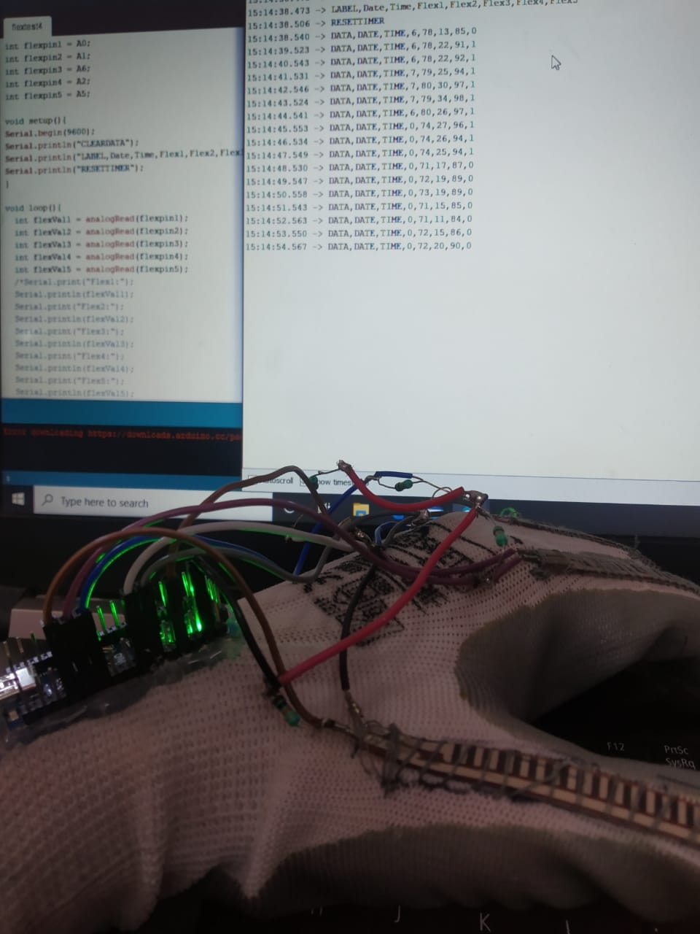

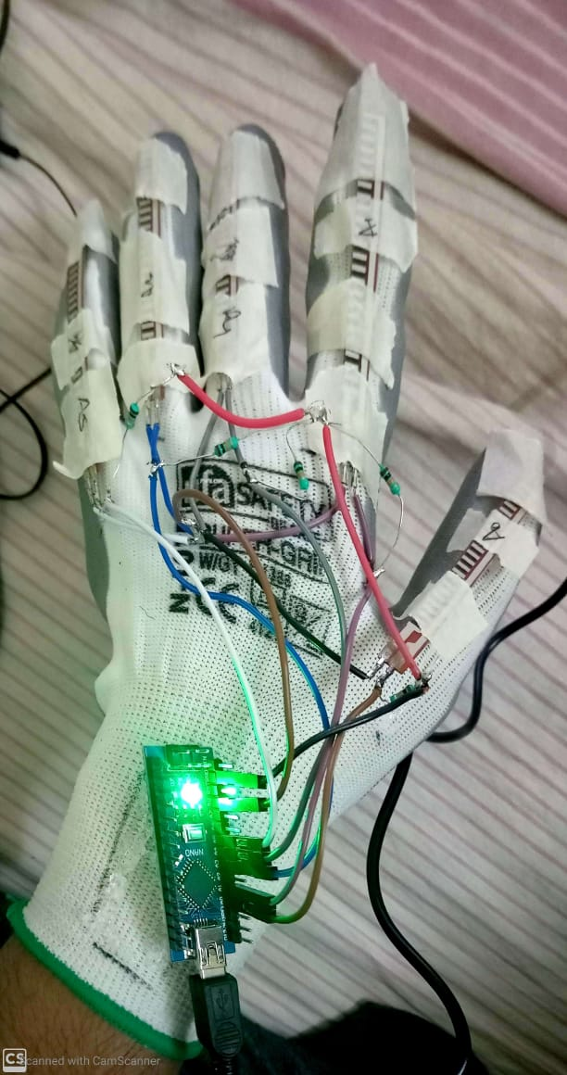
Deaf, Blind & Dumb verbalizer communication system
Institute of Technology & Management GIDA, Gorakhpur
Abhijeet anand (1612010003)
Mohammad Umair (1612010052)
Mohd shahrukh (1612010053)

Slide 2
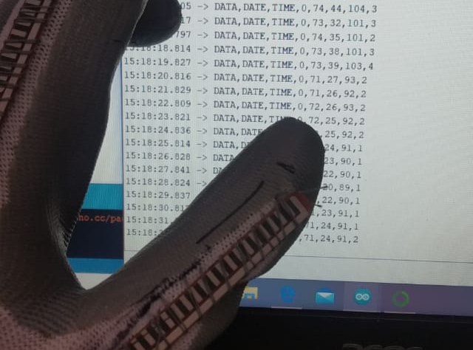
Index
Introduction
Significance of Research Work
Related Work
Review of the previous work
Methodology
Approaches
Conclusion
Future Scope
References

Slide 3
Introduction
Sign language plays a vital role for person with disability (deaf and dumb) to communicate.
One finds difficulty in communicating with others who don’t understand sign languages.
“Indian Sign Language Is A Human Right Of Deaf And Dumb”

Slide 4
Significance of Research Work
The main significance of the smart gloves is to convert the sign language into voice.
It will help the person with disability to communicate easily with others.
Indian sign language consists of various directions and combination of figures which represent the different alphabets.

Slide 5
Related Work
Using the concept of gestures, few systems has been developed in the past.
Using CMOS (Complimentary Metal Oxide Semiconductor) camera.
Flex sensor based glove.
Using image processing technique.

Slide 6
Review of the previous work
Reference | Methodology | Conclusion | Limitation
[1] S. Goyal, I. Sharma and S. Sharma, “Sign language recognition system for deaf and dumb people,” Int. J. Eng. R. Technol., vol. 2, no. 4, pp. 382-387, Apr. 2013. | 1. A direct approach detects the hand gestures. 2. Indian Sign Language (ISL) using the scale invariance Fourier transform (SIFT) algorithm by searching the matched key points between the input image and images stored in a database | 1. Based on the RGB color spaces of the skin color, detects hand gestures. | 1. Requirement of color space. 2. For every alphabet approximately 5 images at different angles and distances need to be stored

Slide 7
Reference | Methodology | Conclusion | Limitation
[2] S. P. More and A. Sattar, “Hand gesture recognition system using image processing,” presented at Int. Conf. Electrical, Electronics, Opt. Techniq., Chennai, India, Mar. 2016 | 1. A method was applied by More et al. using the SIFT algorithm. 2. It reduces the dimensions of the feature vector using a principal component analysis (PCA) algorithm for speeding up the processing time. | 1. Similar to RGB based color space, which reduces dimension using PCA Algorithm | 1. Large database is required in order to store the images.

Slide 8
Methodology
The main purpose is to design a smart wearable glove.
With the help of Flex sensors, the actual movement of figures will be recorded.
Corresponding pattern will be concluded through MATLAB.
Accordingly, the conversion into voice is done.

Slide 9
Approaches
The work started by gathering the relevant resources followed by identifying the modules.
The modules are as follows:
Data collection Module
A custom-made wearable device was taken to hold the hardware.
Hardware Used:
Flex Sensor
Three-axis Accelerometer
Wi-Fi Module
Microcontroller (Arduino Nano)

Slide 10
Table 1.1 Data Set
Date | Time | Flex1 | Flex2 | Flex3 | Flex4 | Flex5
31-03-20 | 7:47:23 PM | 8 | 80 | 35 | 100 | 31
31-03-20 | 7:47:23 PM | 8 | 80 | 34 | 100 | 31
31-03-20 | 7:47:24 PM | 8 | 80 | 34 | 100 | 31
31-03-20 | 7:47:25 PM | 8 | 80 | 34 | 100 | 31
31-03-20 | 7:47:26 PM | 7 | 80 | 34 | 100 | 31
31-03-20 | 7:47:27 PM | 9 | 81 | 34 | 100 | 32
31-03-20 | 7:47:28 PM | 5 | 79 | 34 | 100 | 31
31-03-20 | 7:47:29 PM | 7 | 79 | 34 | 100 | 32
31-03-20 | 7:47:30 PM | 7 | 79 | 32 | 100 | 32
31-03-20 | 7:47:31 PM | 7 | 79 | 34 | 100 | 33
31-03-20 | 7:47:32 PM | 0 | 73 | 33 | 100 | 32
31-03-20 | 7:47:33 PM | 0 | 74 | 34 | 100 | 32
31-03-20 | 7:47:34 PM | 5 | 78 | 33 | 99 | 30
31-03-20 | 7:47:35 PM | 0 | 74 | 33 | 99 | 31
31-03-20 | 7:47:36 PM | 7 | 79 | 32 | 98 | 31

Slide 11
Processing Module
To simplify and optimize the coding implementation, features are extracted from the sensor data and serve as inputs to the built-in SVM classifier to determine the sign language alphabet letters.
Application Module
The service or system converts the received text into an output, which is played back concurrently by the mobile or laptop device speaker.

Slide 12
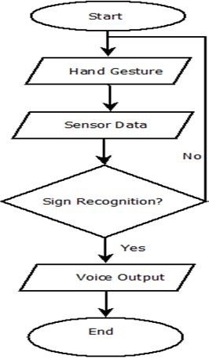
Fig. 1.1 Flow Chart

Slide 13
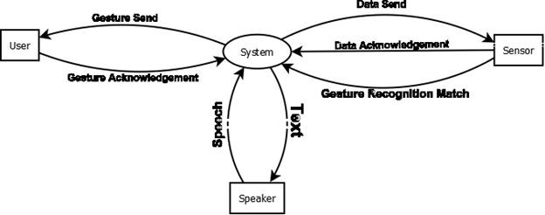
Fig. 1..2 DFD Level-0

Slide 14
CONCLUSION
In this study, we successfully designed and implemented a novel and smart wearable hand device as a sign interpretation system using a built-in SVM classifier.
The participating subjects gave a high rating to the proposed smart wearable sign interpretation system in terms of its comfort, flexibility, and portability.
The device holders were simple gloves using a flexible nature, so that it can fit different hand and finger sizes, thus eliminating the necessity of custom-made devices.

Slide 15
FUTURE SCOPE
Our main aim is to reach every person who feels desperate due to their disability at the utmost cost effective solution.
This prototype can be further modified to accommodate the sign language gesture alongside with the already existing alphabets.
The Android Application can be customized to add further features like incorporation of voice for the sign language gestures and alongside display the history of texts for previously executed gestures.

Slide 16
References
J. Wang and T. Zhang, “An ARM-based embedded gesture recognition system using a data glove,” presented at the 26th Chinese Control and Decision Conf., Changsa, China, May 31 - June2, 2014.
A. Z. Shukor, M. F. Miskon, M. H. Jamaluddin, F. A. Ibrahim, M. F. Asyraf and M. B. Bahar, “A new data glove approach for Malaysian sign language detection,” Procedia Comput. Sci., vol. 76, no. 1, pp. 60-67, Dec. 2015.
N. Sriram and M. Nithiyanandham, “A hand gesture recognition based communication system for silent speakers,” presented at the Int. Conf. Human Comput. Interact., Chennai, India, Aug. 23-24, 2013.
S. V. Matiwade and M. R. Dixit, “Electronic support system for deaf and dumb to interpret sign language of communication,” Int. J. Innov. Research Sci. Eng. Technol., vol. 5, no. 5, pp. 8683-8689, May 2016.

Slide 17
S. Goyal, I. Sharma and S. Sharma, “Sign language recognition system for deaf and dumb people,” Int. J. Eng. R. Technol., vol. 2, no. 4, pp. 382-387, Apr. 2013
B. G. Lee, Member, IEEE, and S. M. Lee “Smart Wearable Hand Device for Sign Language Interpretation System with Sensors Fusion” DOI 10.1109/JSEN.2017.2779466, IEEE Sensors Journal.
C. L. Lim, C. Rennie, R. J. Barry, H. Bahramali, I. Lazzaro, B. Manor and E. Gordon, “Decomposing skin conductance into tonic and phasic components,” Int. J. Psychophys., vol.25, no. 2, pp. 97-109, Feb. 1997.
S. P. More and A. Sattar, “Hand gesture recognition system using image processing,” presented at Int. C onf. Electrical, Electronics, Opt. Techniq., Chennai, India, Mar. 2016.
K. Murakami and H. Taguchi, “Gesture recognition using recurrent neural network,” in Proc. SIGCHI Conf. Human Factors Comput. Syst., New York, USA, 1991

Slide 18
P. R. V. Chowdary, M. N. Babu, T. V. Subbareddy, B. M. Reddy and V. Elamaran, “Image processing algorithms for gesture recognition using matlab,” presented at Int. Conf. Adv. Comm. Control Comput. Technol., Ramanathapurum, India, Jan. 2015.
T. Khan and A. H. Pathan, “Hand gesture recognition based on digital image processing using matlab,” Int. J. Sci. Eng. R., vol. 6, no. 9, pp. 338-346, Sep. 2015.
J. Siby, H. Kader and J. Jose, “Hand gesture recognition,” Int. J. Innov. Technol. R., vol. 3, no. 2, pp. 1946-1949, March 2015.
S. P. Dawane and H. G. A. Sayyed, “Hand gesture recognition for deaf and dumb people using gsm module,” Int. J. Sci. R., vol. 6, no. 5, pp. 2226-2230, May 2017.
C. Preetham, G. Ramakrishnan, S. Kumar and A. Tamse, “Hand talk- implementation of a gesture recognizing glove,” presented at 2013 Texas Instruments India Educators’ Conf., Bangalore, India, Apr. 4-6, 2013.
K. Patil, G. Pendharkar and G. N. Gaikwad, “American sign language detection,” Int. J. Sci. R. Pub., vol. 4, no. 11, pp. 1-6, Nov. 2014.
J. Kim, N. D. Thang and T. Kim, “3-D hand motion tracking and gesture recognition using a data glove,” presented at IEEE Int. Symp. Industrial Elec. 2009, Seoul, South Korea, Jul. 5-8, 2009.

Slide 19
D. Lu, Y. Yu and H. Liu, “Gesture recognition using data glove: an extreme learning machine method,” in Proc. 2016 IEEE Int. Conf. Robotics and Biomimetics, Qingdao, China, Dec. 3-7, 2016.
J. Lm, D. Lee, B. Kim, I. Cho and J. Ryou, “Recognizing hand gestures using wrist shapes,” presented at 2010 Digest Technical Papers Int. Conf. Consumer Elec., Las Vegas, USA, Jan. 9-13, 2010.
R. Xie, X. Sun, X. Xia and J. Cao, “Similarity matching-based extensible hand gesture recognition,” IEEE Sensors J., vol. 15, no. 6, pp. 3475-3483, Jun. 2015.
Y. L. Hsu, C. L. Chu, Y. J. Tsai and J. S. Wang, “An inertial pen with dynamic time warping recognizer for handwriting and gesture recognition,” IEEE Sensors J., vol. 15, no. 1, pp. 154-163, Jan. 2015.
L. Yin, M. Dong, Y. Duan, W. Deng, K. Zhao and J. Guo, “A high-performance training-free approach for hand gesture recognition with accelerometer,” Mult. Tools App., vol. 72, no. 1, pp. 843-864, Sep. 2014.

Slide 20
J. Galka, M. Masior, M. Zaborski, K. Barczewska, “Inertial motion sensing glove for sign language gesture acquisition and recognition,” IEEE Sensors J., vol. 16, no. 16, pp. 6310-6316, Aug. 2016.
X. Cai, T. Guo, X. Wu and H. Sun, “Gesture recognition method based on wireless data glove with sensors,” Sensor Letters, vol. 13, no. 2, pp. 134-137, Feb. 2015.
K. Liu, C. Chen, R. Jafari and N. Kehtarnavaz, “Fusion of inertial and depth sensor data for robust hand gesture recognition,” IEEE Sensors J., vol. 14, no. 6, pp. 1898-1903, Jun. 2014.
K. W. Kim, M. S. Lee, B. R. Soon, M. H. Ryu and J. N. Kim, “Recognition of sign language with an inertial sensor-based data glove,” Technol. Health Care, vol. 24, no. 1, pp. 223-230, 2016.
L. Sousa, J. M. F. Rodrigues, J. Monteiro, P. J. S. Cardoso and R. Lam, “GyGSLA: a portable glove system for learning sign language alphabet,” presented at Int. Conf. Universal Access in Human-Comput. Interact., Toronto, ON, Canada, Jul. 17-22, 2016.

Slide 21
N. Caporusso, L. Biasi, G. Cinquepalmi, G. F. Trotta and A. Brunetti, “A wearable device supporting multiple touch- and gesture-based languages for the deaf-blind,” presented at Int. Conf. Appl. Human Factors and Ergonomics, LA, CA, USA, Jul. 17-21 2017.
Z. Yu, X. Chen, Q. Li, X. Zhang and P. Zhou, “A hand gesture recognition framework and wearable gesture-based interaction prototype for mobile devices,” IEEE Trans. Human-Mach. Syst., vol. 44, no. 2, pp. 293-299, Apr. 2014.
J. Wu, Z. Tian, L. Sun, L. Estevez and R. Jafari, “Real-time American sign language recognition using wrist-worn motion and surface emg sensors,” presented at IEEE 12th Int. Conf. Wearable Implantable Body Sensor Net., Cambridge, USA, Jun. 9-12, 2015.
J. Wu, L. Sun and R. Jafari, “A wearable system for recognizing American sign language in real-time using imu and surface emg sensors,” IEEE J. Biomedic. Health Info., vol. 20, no. 5, pp. 1281-1290, Sept. 2016.
[NAS73] Nassi, I. and B. Shneiderman, "Flowchart Techniques for Structured Programming," SIGPLAN Notices, ACM, August 1973.
[CHA74] Chapin, N., "A New Format for Flowcharts," Software—Practice and Experience, vol. 4, no. 4 , 1974, pp. 341–357.

Slide 22
